Slide 1

MESA DE ACCESO UNIVERSAL
A LA ENERGÍA
(MAUE)
AFFORDABLE, RELIABLE, SUSTAINABLE AND MODERN ENERGY FOR ALL

Slide 2

OUR RAISON D’ÊTRE
    670 millions people have no access to electricity (UN may 2023)
    2,600 million people use solid fuels for heating and cooking
    A range of 9.3% to 16.4% of Spanish households are in energy poverty
Access to energy is essential if the goal is to alleviate poverty, secure Human Rights and compliance with SDGs

Slide 3
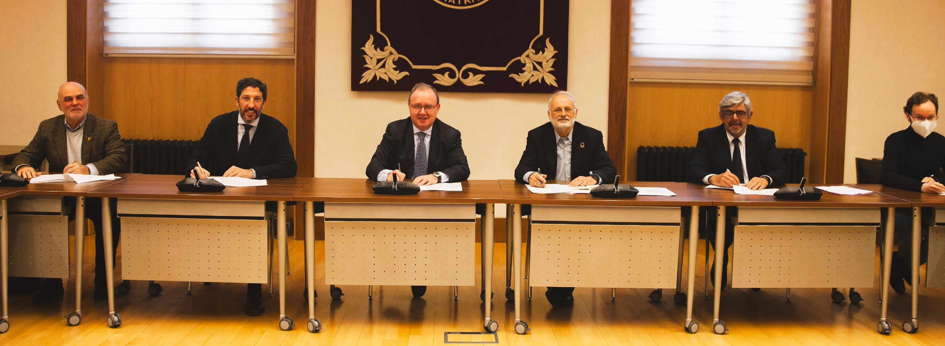
MAUE
An Association to promote Universal Access to Energy established in 2023
  A non-profit organization established under article 22 of the Spanish Constitution
  Working since 2024 as a collaborative platform
  Having a full legal status to work for its own goals

Slide 4
OUR VISION
Universal Access to modern and secure forms of energy is a human right
Universal Access to energy is a duty shared by all of us
Energy is a requisite for development. Without energy there is no possibility of development
Access to energy has to be enough to allow a decent life and make possible human development
Any activity to achieve access to energy has to inevitably take into account its economic, environmental and social sustainability
Access to energy in isolated rural communities requires the deployment of innovative models to provide this service with the active participation of final consumers

Slide 5

OUR GOALS
Main goals:
Foster Universal Access to Energy (AUE)
Alleviate Energy Poverty (PE)
Secondary goals:
Facilitate and promote coordinated activities of both public and private actors that can help to achieve the AUE and eradicate Energy Poverty (PE)
Develop, together with its members and other organizations projects oriented to achieve the AUE and alleviate PE
Make society aware, as well as those responsible for, of the necessity that AUE could be a reality as soon as possible.
Implement a forum for Exchange of opinions and experience on AUE and PE
Foster developments and innovations, either technological or managerial, for carrying out AUE and PE projects
GOALS

Slide 6







OUR MEMBERS

Slide 7

ORGANIZATION
MEMBERS/GENERAL ASSEMBLY
MANAGING BOARD
Chairman
Vice chairman
Board members

Slide 8

COOPERATION AMONG MEMBERS (1)
Perú (Acciona.org-Esf-FICAI),2013: project ”Electrification of 10 community centers in Cajamarca by means of FV systems (Perú)”.
Perú (Acciona.org-FICAI), 2015: project “Rural electrification by means of supply and services centers (ERCESS)”.
Perú (Acciona.org-FICAI-IIT), 2017: project “Electricity supply with renewable sources in isolated communities in the Napo river basin (Peruvian Amazon region)”.
Colombia (FICAI-Waya-IIT), 2020: Consultancy to identify and evaluate international experiences in the implementation of innovative models for energy access
Bolivia (IIT – Waya - TTA), 2022: Elaboration and implementation of the Bolivian Integrated National Plan for Rural Electrification

Slide 9
COOPERATION AMONG MEMBERS (2)
Panamá (FICAI-Waya-IIT), 2023: Consulting for the development of financing mechanisms for energy access in Panama.
Panamá (FICAI-Waya-IIT-TTA,2023: Drafting of the Rural National Electrification Plan as a basis to achieve the goal of universal energy access.
Perú (FICAI-Waya-IIT-TTA), 2023: Making of the Georeferenced Plan for universal access to electricity in Perú
Brazil (Waya-IIT- TTA),2023: Making of the Georeferenced Plan for Universal Access to Electricity in Brazil
Suriname (TTA - Waya), 2023: Drafting of the Rural Electricity Plan in Suriname to support the goal of universal energy access in 2030

Slide 10
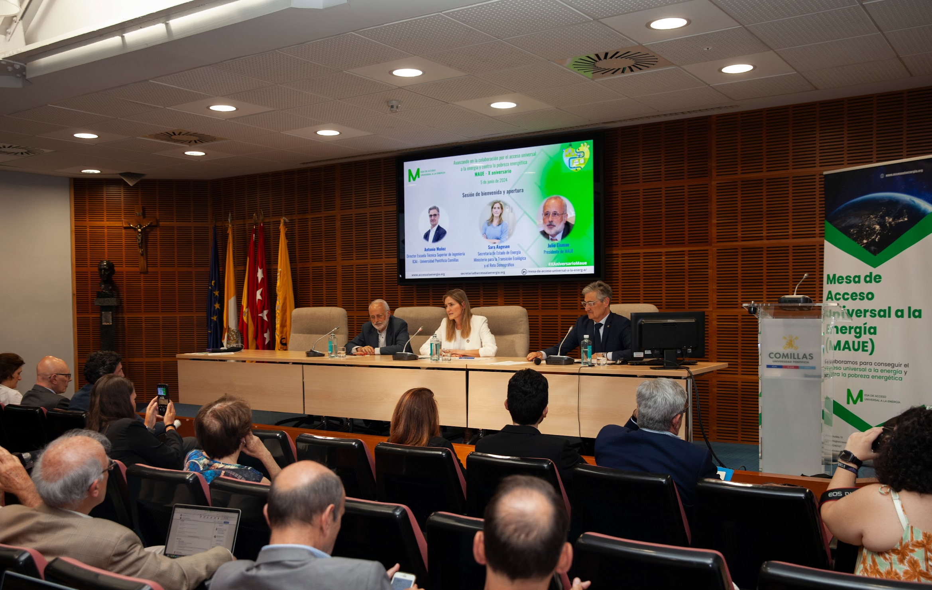
MAUE IN FORI AND EVENTS(1)
:
MAUE X Anniversary
“Moving forward in the cooperation to achieve universal access to energy and against energy poverty”
Madrid, 5th June 2024
Session 1 “Electrifying the last mile: Ibero-America case”
. Luis Jesús Sánchez de Tembleque (Secretary ARIAE)
. José Gabriel Martín (Director Acciona.org)
. Andrés González (co-director and co-founder Waya Energy)
. Moderator: Mariano Molina (Energía sin Fronteras).
Session 2 “Massive Access to energy: Africa case”
. Carlos Sordo (GOGLA)
. Nicolás Larrañaga (TTA)
. Moderator: Ignacio Pérez-Arriaga
Session 3 “Eradicating energy poverty in a transient Europe ”
. Ester Sevilla (Fundación Naturgy)
. Cecilia Foronda (Ecodes)
. Sergio Tirado (ACA)
. Moderator: Roberto Barrella (Comillas-ICAI)
Opening Session Sara Aagesen - Secretary of State for Energy

Slide 11

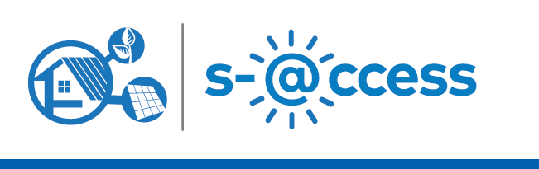
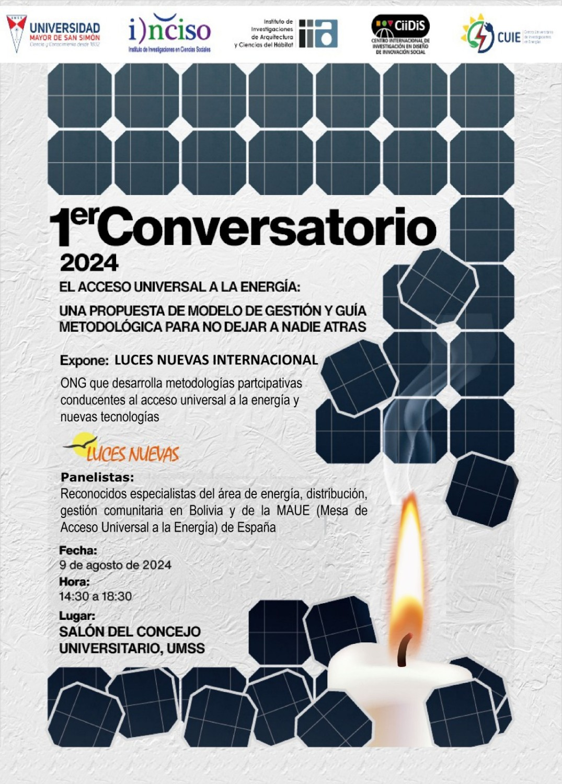
MAUE IN FORI
AND EVENTS (2)
“Last Mile Electrification in Ibero-America”,
5th S-@ccess Conference, University of the Balearic Islands
Mallorca, September 2024
Round Table on universal Access to energy in Bolivia
Organized by Luces Nuevas, hold at Universidad Mayor San Simón (UMSS), Instituto de Ciencias Sociales (INCISO).
Cochabamba (Bolivia), August 2024
“Electrifying the last mile in Ibero-America”.
Presentation to the VII International Congress on Studies for Development «Just transitions and deals for sustainable development»
Universidad Complutense de Madrid.
Madrid, May 2024

Slide 12
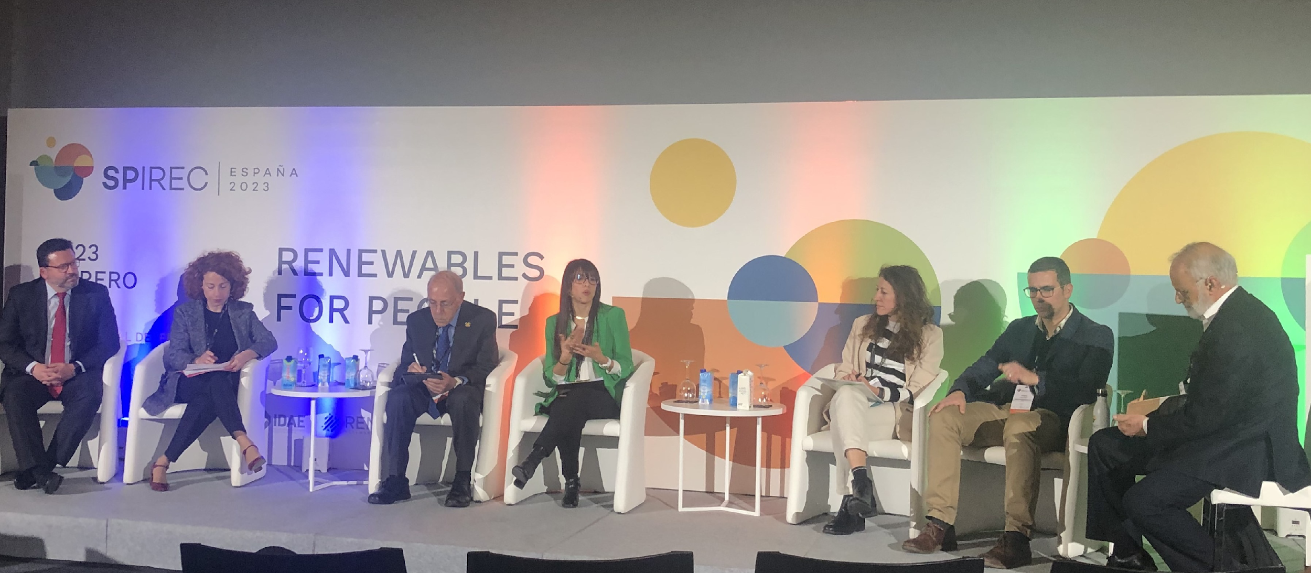
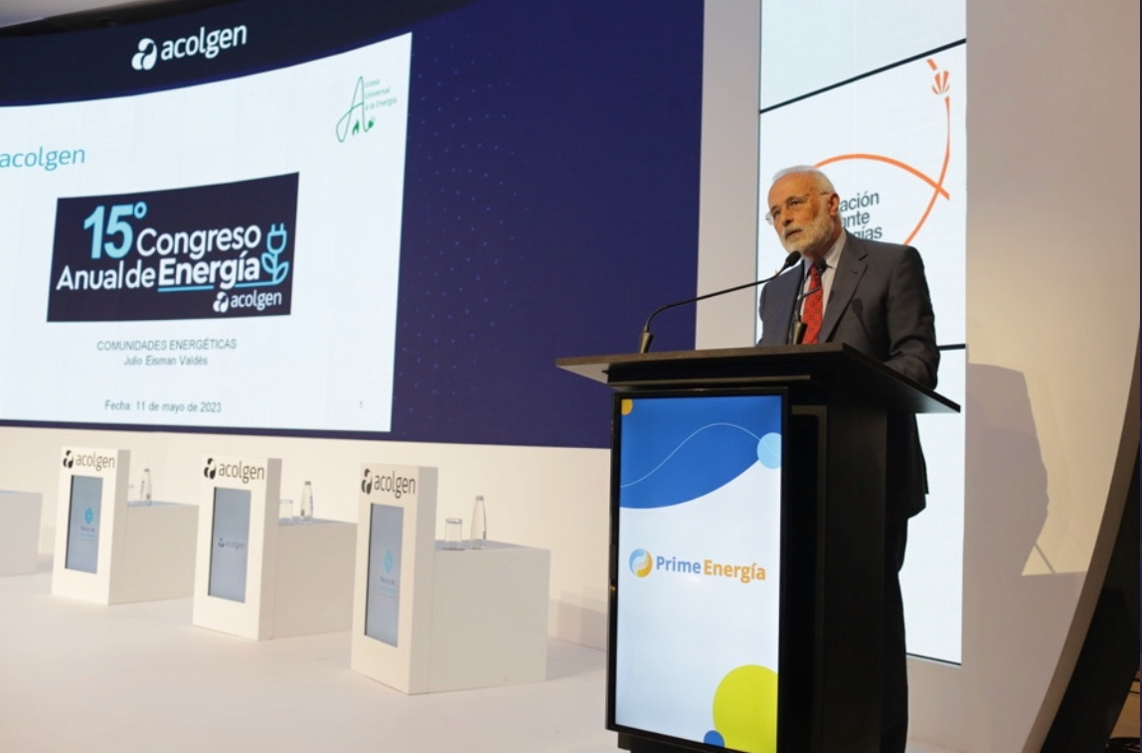
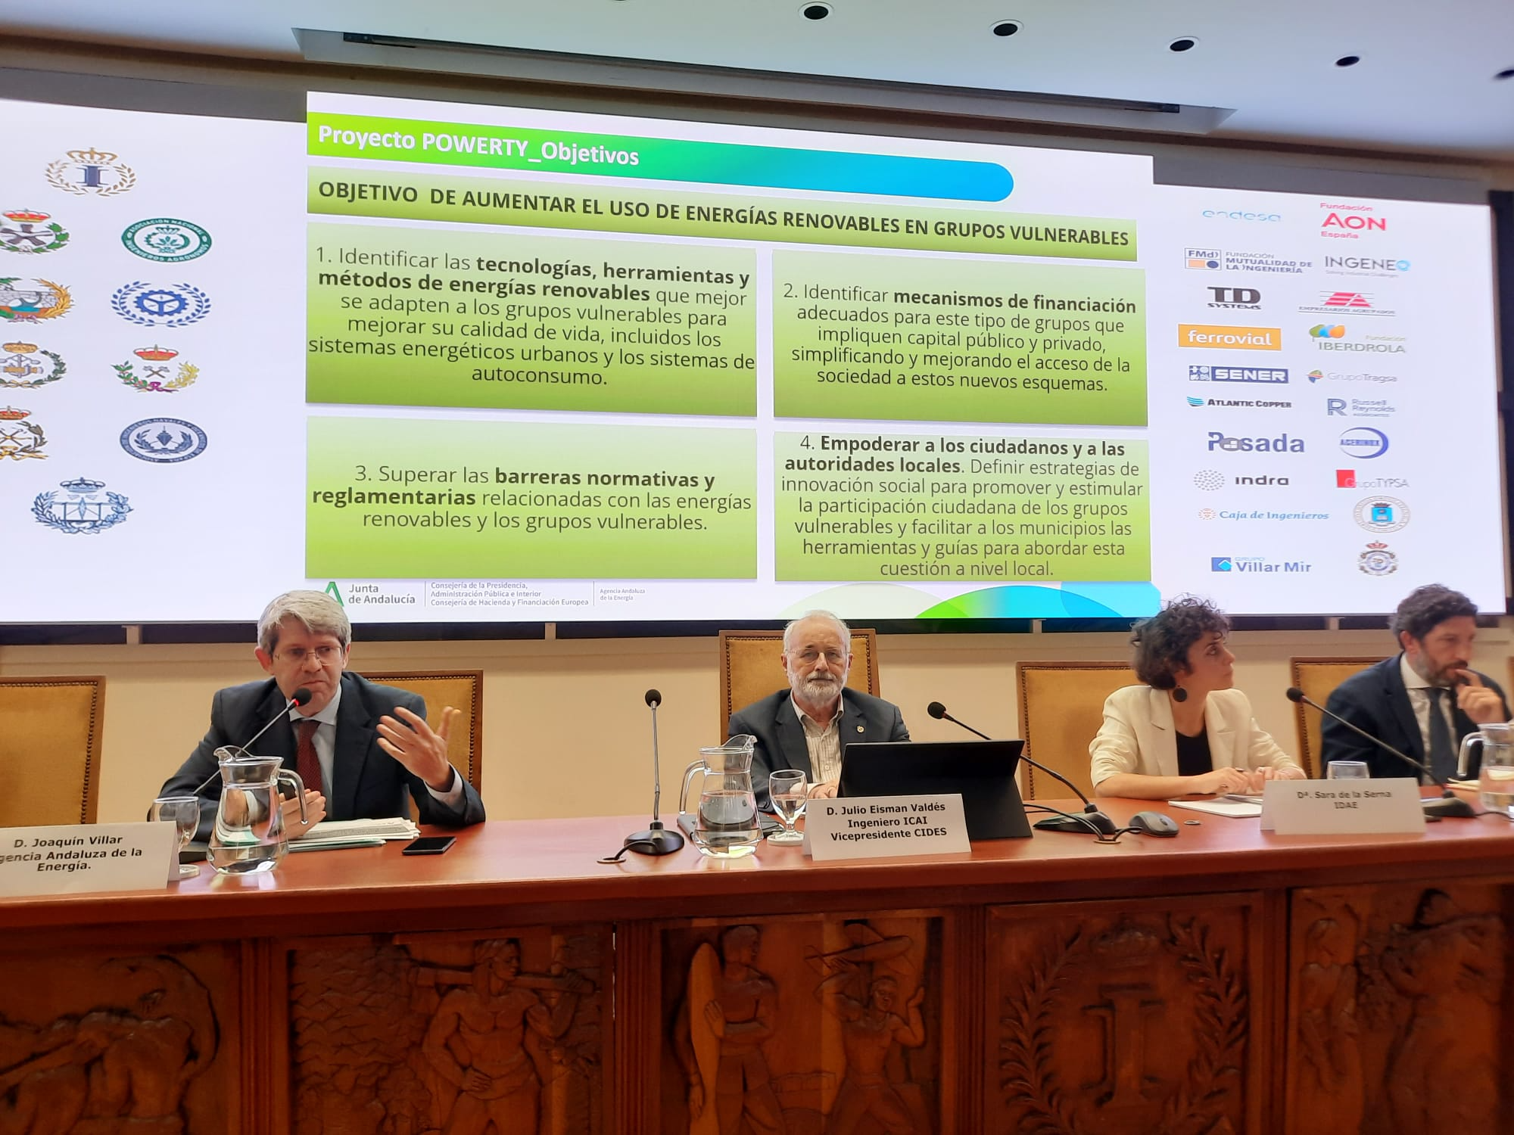
MAUE IN FORI
AND EVENTS (3)
Organizer Round Table “Renewable Energy to achieve universal energy access”.
International Renewable Energy Congress (IREC).
Madrid, 2023
Conference on “Energy communities” 15th Annual Congress on Energy,
Asociación Colombiana de Generadores de Electricidad (ACOLGEN).
Bogotá (Colombia), 2023.
Organizer of the topical session on “Energy communities”
Spanish Engineering Institute
Madrid, 2022

Slide 13
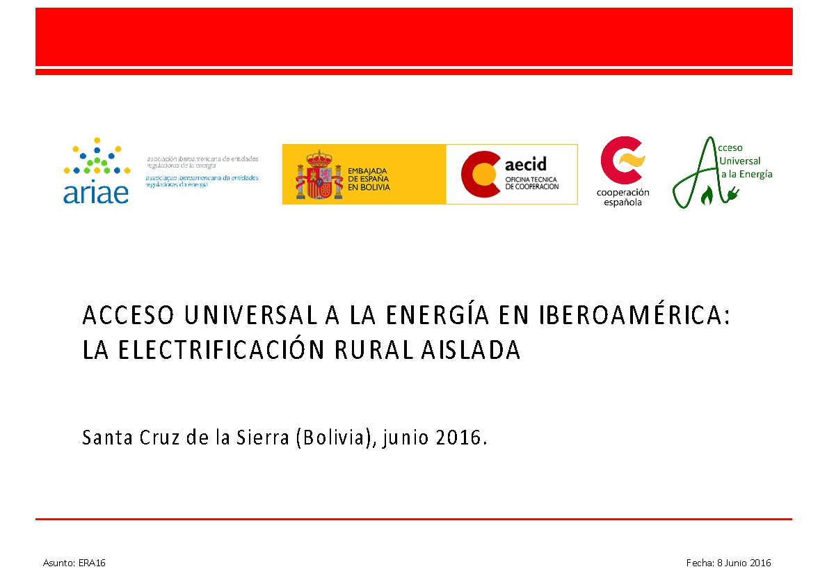


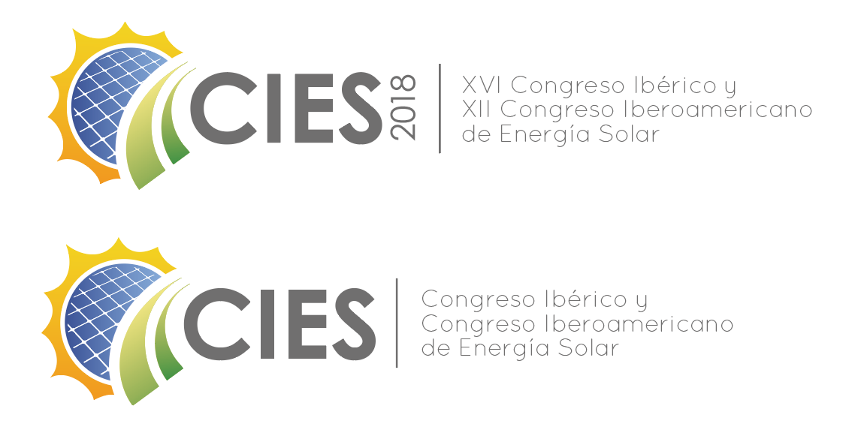

MAUE IN FORI
AND EVENTS (4)
IV Seminar on Universal Access to Energy. Electrification of isolated rural areas.
Seminar organized by MAUE jointly with AECID and ARIAE on Universal Access to Energy in Ibero-America.
La Antigua (Guatemala), 2019
Round Table organized by La Casa Encantada in cooperation with MAUE on “PV electrification for isolated areas in Ibero-América”
XII Congreso Iberoamericano de Energía Solar.
Madrid, 2018
Organizer of the topical Session “Renewable Energy and universal Access to energy-SDG7” as part of the event “Renewable energy at hand”organized by La Casa Encendida and the
Escuela Técnica Superior de Ingeniería y Diseño Industrial.
Madrid, 2017

Slide 14
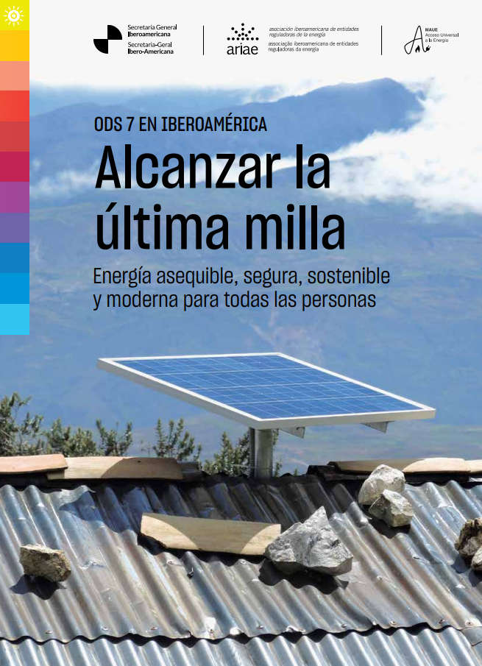
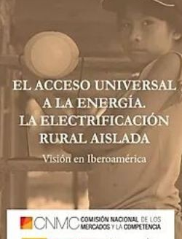
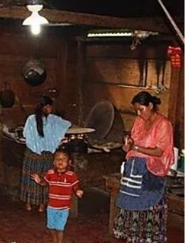
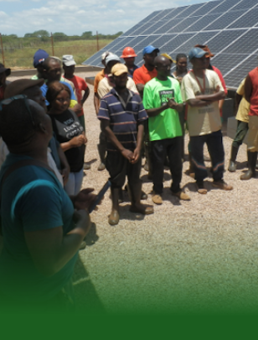
PUBLICACIONES
Dedicated report presented to the 2021 Ibero-American Head of State Summit
Proceedings. Seminar on Universal Access to Energy. Isolated rural electrification. Bolivia 2016
A collective reflection on the proper level of Access to energy. 2015
Proposals to incorporate “Universal Access to Energy” in the Spanish Cooperation. 2014

Slide 15

Why being a member of MAUE?
Positioning your organization as a promoter of Universal Access to Energy and against energy poverty
Commitment of your organization to achieve the goal 7.1 of SDG (Universal Access to clean energy)
Collaboration with other organizations that also share MAUE’s objective as to achieve a better impact and influence
Increasing your capacity to draw and retain talent in your organization
Possibility of adding your contributions in MAUE’s statements, positioning, studies and assessments

Slide 16
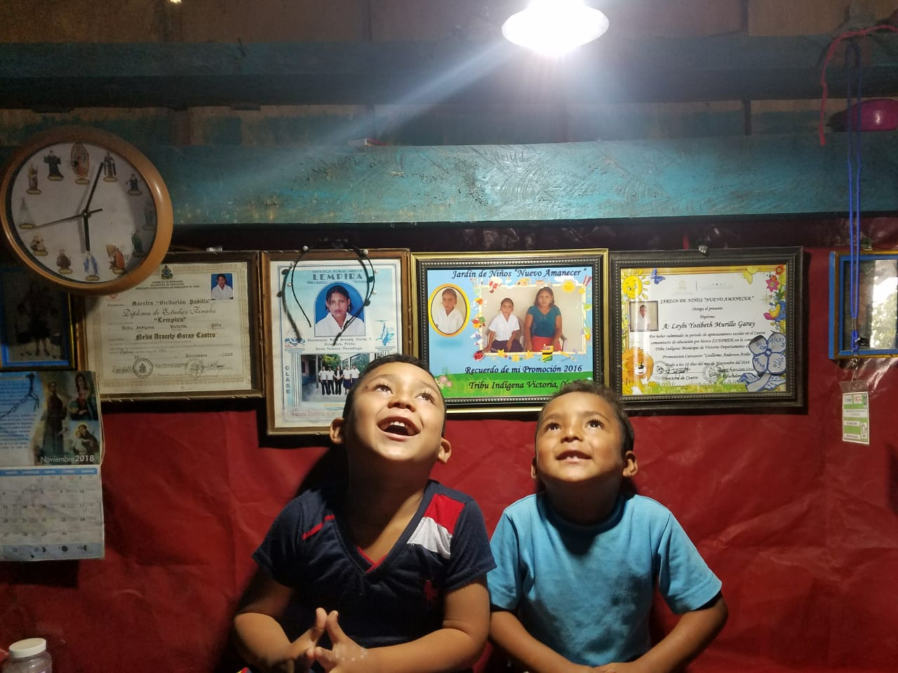


MAUE
Thank you for your attention!
Where we are?
https://accesoalaenergia.org/
https://www.linkedin.com/company/mesa-de-acceso-universal-a-la-energ-a
@accesoenergia.es
@mesaaccesoenergia
Calle Maudes 51. Madrid 28003 – Spain

